Slide 1
Connect With Real World of Solid Edge Programming
Kevin Haen, IT Manager, Curt G. Joa, Inc.

Slide 2
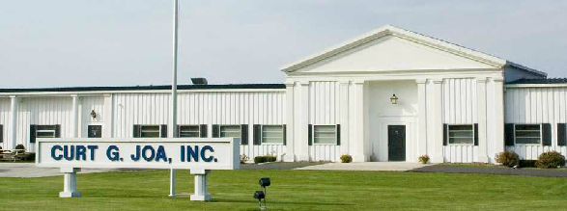
Curt G. Joa, Inc. Sheboygan Falls, WI
Family Owned Company started in 1932
OEM of top-tier non-woven converting machinery
75+ users on Solid Edge & Teamcenter

Slide 3
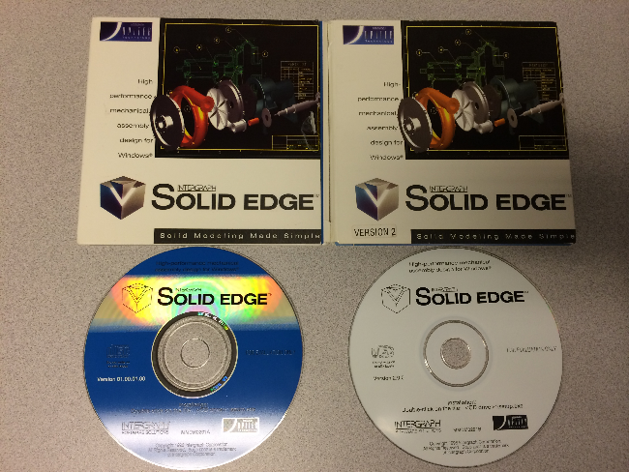
Used Solid Edge Since Beginning

Slide 4
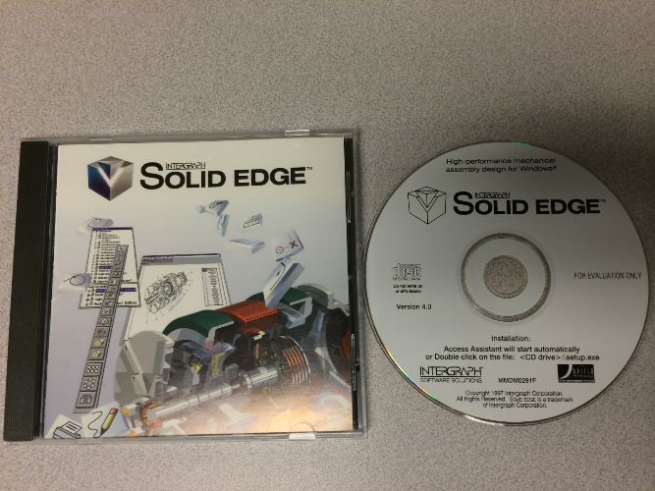
Actually Implemented in V4.

Slide 5
My Random Comments
Use primarily VB.NET.
Some of my methods maybe be outdated.
No longer create Add-ins.
Keep all Apps local. Synchronize at login and manually.
Hoping to get everyone to think about other possibilities.

Slide 6
Why Automation?
Increase productivity.
Reduce repetitive steps.
Best way to enforce standards is to make it much easier/faster to do it the right way.
Make disparate business systems seem integrated.

Slide 7





Disparate Systems
Siemens
Teamcenter
Siemens
Solid Edge
Workwise
RB-ERP
Microsoft
SharePoint
Dash
DDX

Slide 8
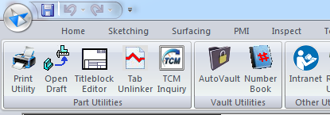
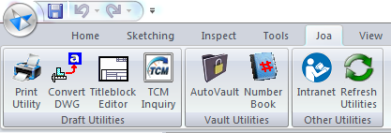
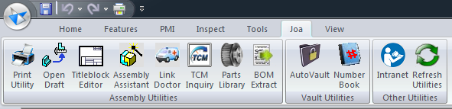
Joa Toolbar Tabs
Part/Sheet Metal
Draft
Assembly

Slide 9
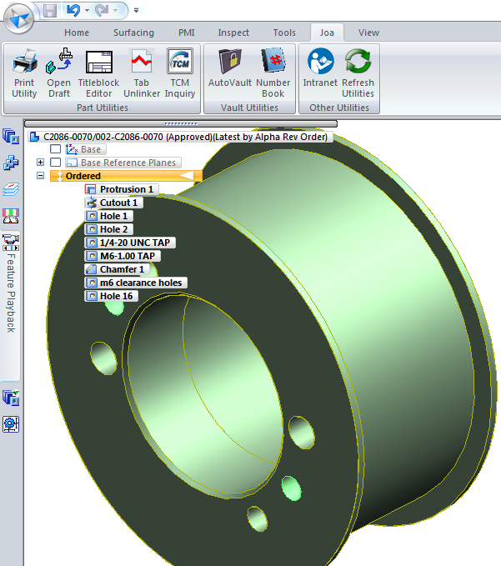
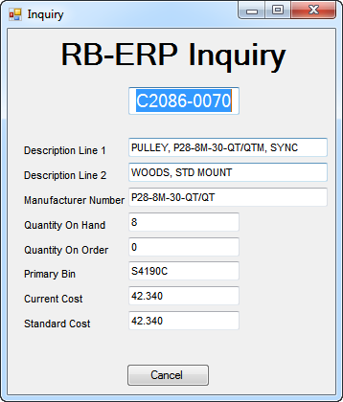
ERP- Inquiry (Part, Draft, Sheet Metal)

Slide 10
ERP-Inquiry Code Basics
txtNumber.Text = EdgePart.Properties("ProjectInformation").Item("Project Name").Value.ToString.ToUpper
lstconnection.ConnectionString = connstring
lstconnection.Open()
lstCB = New SqlCommand("SELECT * FROM joa.itmmas_eng WHERE ID_ITEM = '" & txtNumber.Text & "'", _
lstconnection)
lstSR = lstCB.ExecuteReader()
If lstSR.HasRows Then
lstSR.Read()
txtDescription1.Text = lstSR("DESCR_1").ToString
txtDescription2.Text = lstSR("DESCR_2").ToString
txtManuNumber.Text = lstSR("KEY_ALT").ToString
txtPrimaryBin.Text = lstSR("BIN_PRIM").ToString
txtQtyOnOrder.Text = lstSR("QTY_ONORD").ToString
txtQtyOnHand.Text = lstSR("QTY_ONHD").ToString
txtCurCost.Text = lstSR("curr_cost").ToString
txtxStdCost.Text = lstSR("std_cost").ToString
End If
lstSR.Close()
lstconnection.Close()
lstconnection = Nothing

Slide 11
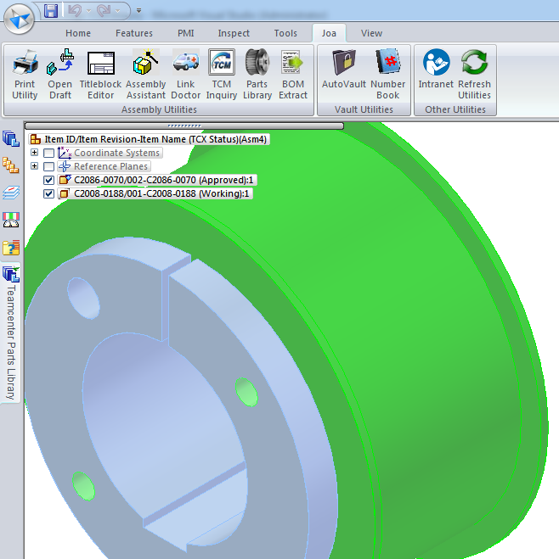
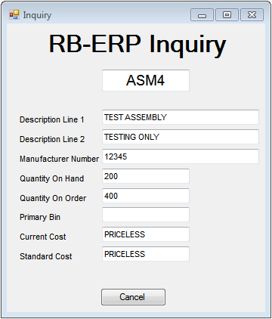
ERP- Inquiry (Assembly with Nothing Selected)

Slide 12
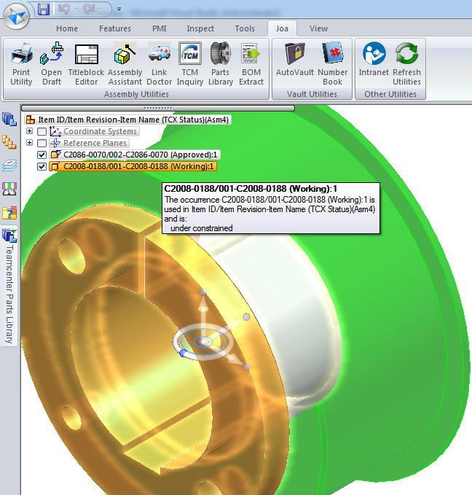
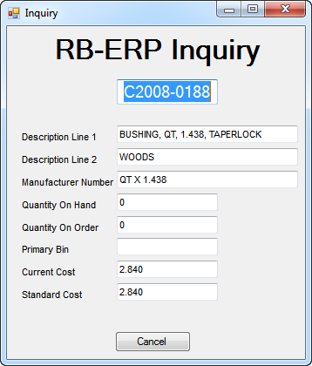
ERP- Inquiry (Assembly with a Child Selected)

Slide 13
ERP-Inquiry (Assembly Code)
If UCase(EdgeApp.ActiveEnvironment) = "ASSEMBLY" Then
If EdgeAssy.SelectSet.Count > 0 Then
txtNumber.Text =EdgeAssy.SelectSet.Item(1).PartDocument.Properties("ProjectInformation")._
Item("Project Name").Value.ToString.ToUpper()
Else
txtNumber.Text = EdgePart.Properties("ProjectInformation").Item("Project Name").Value.ToString.ToUpper()
End If

Slide 14
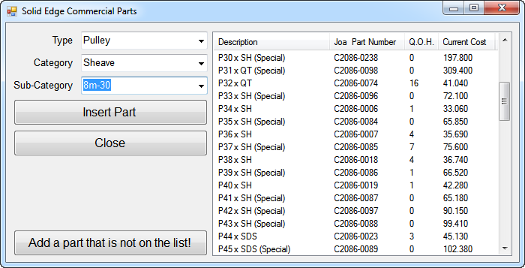
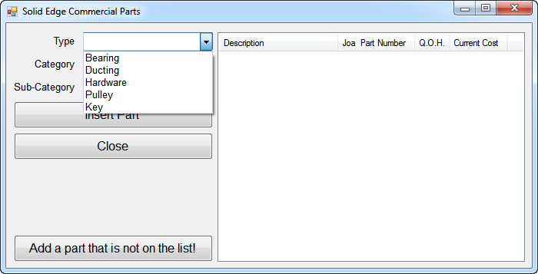
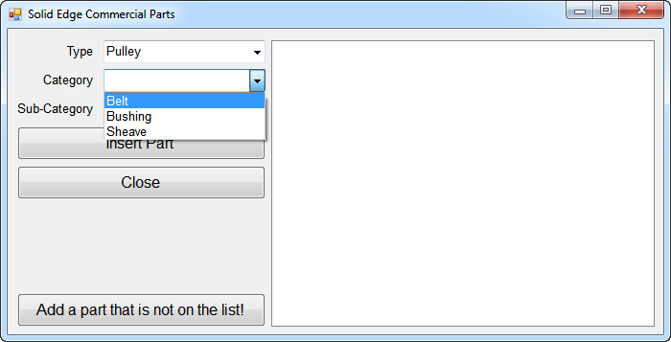
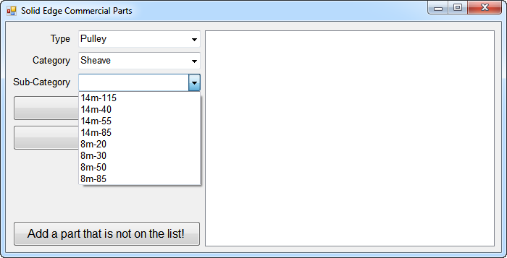
Parts Library

Slide 15

Open Draft
NewName = EdgePart.FullName.Substring(0, EdgePart.FullName.Length - 3) & "dft"
NewNameShort = EdgePart.Name.Substring(0, EdgePart.Name.Length - 3) & "dft“
DocOpen = False
For DocCount = 1 To EdgeApp.Documents.Count
If UCase(EdgeApp.Documents.Item(DocCount).Name) = UCase(NewNameShort) Then
EdgeApp.Documents.Item(DocCount).Activate()
DocOpen = True
Exit For
End If
Next DocCount
If DocOpen = False Then
If System.IO.File.Exists(NewName) Then
EdgeApp.Documents.Open(NewName)
Else
MsgBox("Sorry, Draft Not Found", vbOKOnly, "Draft open Error")
End If
End If

Slide 16
Open Draft (Assembly Option)
If UCase(EdgeApp.ActiveEnvironment) = "ASSEMBLY" Then
If EdgeAssy.SelectSet.Count > 0 Then
DocName = EdgeAssy.SelectSet.Item(1).PartDocument.FullName
DocNameShort = EdgeAssy.SelectSet.Item(1).PartDocument.Name
Else
DocName = EdgeAssy.FullName
DocNameShort = EdgeAssy.Name
End If
End If

Slide 17
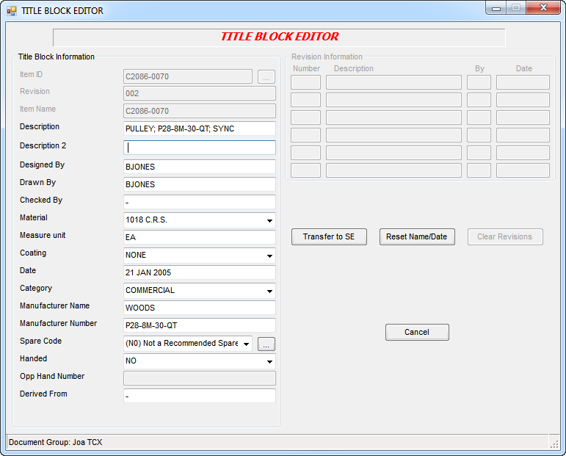
Title Block Editor

Slide 18

Link Doctor
For Each EdgeOccurrence In EdgeOccurrences
If System.IO.File.Exists(EdgeOccurrence.PartFileName) = False Then
NewFileName=…………..
EdgeOccurrence.Replace(NewFileName, True)
End If
Next

Slide 19

Intranet Shortcut
Shell("explorer http://joa/Engineering/Mechanical/TeamPages/SolidEdge/default.aspx",_
AppWinStyle.NormalFocus, True)

Slide 20

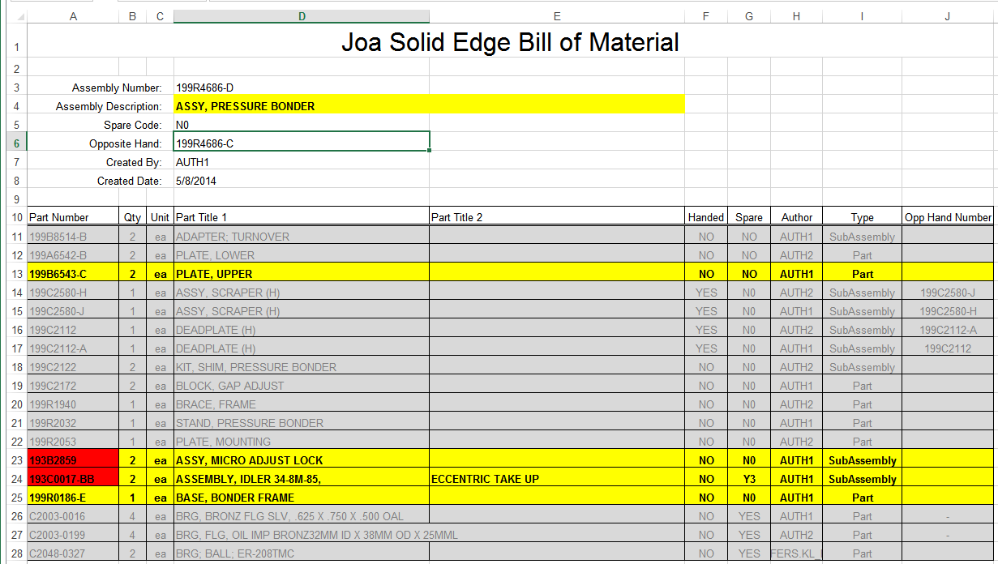
Bill of Material Transfer

Slide 21
File Open for Sharepoint
(Sorry, Old VB6 code)
Function PDMDir(FileName As String) As String
PDMDir = "sites/vault/InWork/"
Dim bFileExists As Boolean = False
Dim cnt, Pos As Integer
rs.Open "SELECT DirName, LeafName From Docs WHERE (LeafName LIKE '" & FileName & "') _
AND (DirName = '" & PDMDir & "')", cn
PDMDir = ""
While Not rs.EOF And bFileExists = False
If UCase(FileName) = UCase(Left(rs!leafname, Len(FileName))) Then
bFileExists = True
PDMDir = rs!leafname
End If
rs.MoveNext
Wend
rs.Close
End Function

Slide 22

Kevin Haen IT Manager Curt G. Joa, Inc.
100 Crocker Avenue Sheboygan Falls, WI 53085
Phone: (920) 467-7465
E-mail: khaen@joa.com

